Slide 1


Linked metadata of the Science Library and the National Library

Slide 2
What: Biblioteka Nauki offers full texts of scientific articles and selected books published in Polish journals.
Scope: Covers five major subject databases (AGRO, BazTech, CEJSH, DML-PL, PS

Slide 3
Objective
To enhance the value and usability of Biblioteka Nauki by comparing and matching its records with those of the National Library.

Slide 4
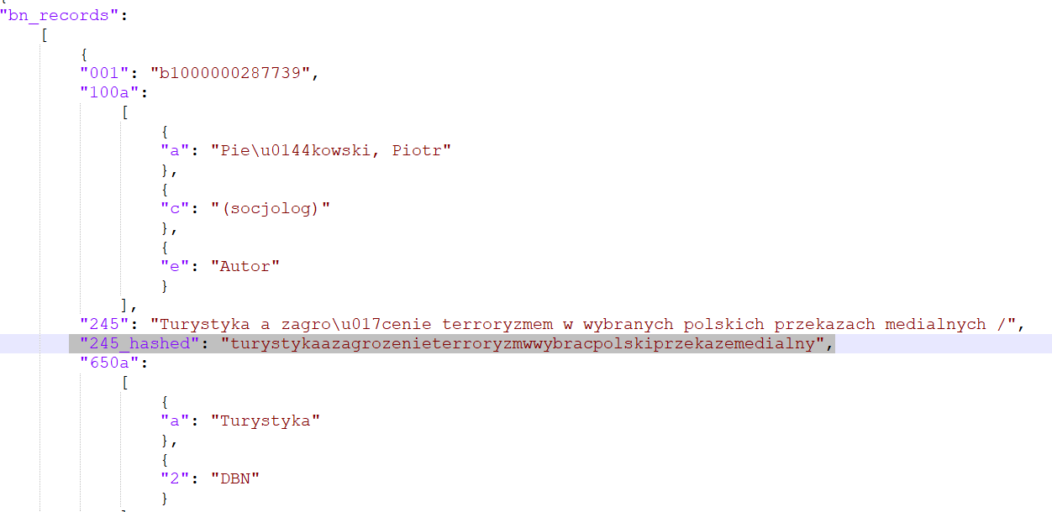
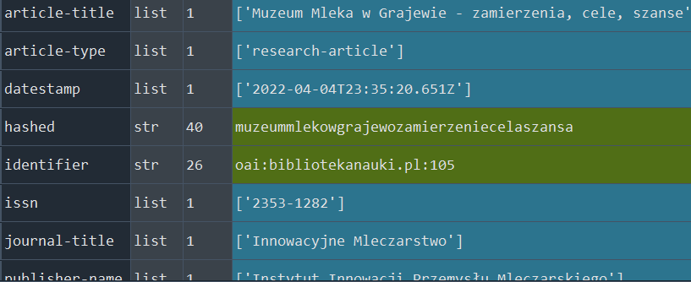
Methodology
Lemmatized titles using the spacy tool and pl_core_news_lg model.
Removed Polish characters, special characters, uppercase letters, and spaces.
Compared strings using the Levenshtein algorithm.
Set a threshold of 0.86 ratio for matches.

Slide 5
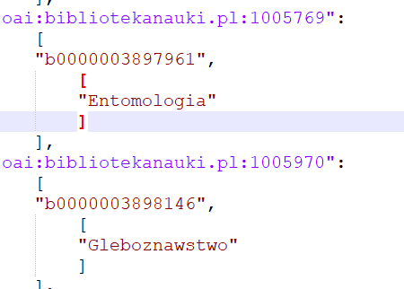
Results
Matched 119,656 bibliographic records.
Generated subject headings for Biblioteka Nauki using the National Library's data.
ID Biblioteka Narodowa
ID Biblioteka Nauki

Slide 6
Benefits
Comprehensive Database:
Users can now cross-reference data across multiple domains.
Greater depth of information with subject headings.
ID Biblioteka Nauki
ID Biblioteka Narodowa

Slide 7
Why It Matters
Easier and more effective for researchers to find relevant information.
Encourages academic growth and quality research in Poland.

Slide 8
Conclusion
Our work could significantly enrich the user experience of Biblioteka Nauki
Paves the way for more integrated, searchable, and valuable research databases in the future

